Slide 1

Civic Engagement in Minnesota
MnDOT Public Engagement Workshop 3-13-2018
Nick Kor | Civic Engagement Director
Minnesota Department of Human Rights
Rowzat Shipchandler| Deputy Commissioner
Minnesota Department of Human Rights

Slide 2
“The intentional effort of government to facilitate meaningful dialog with all members of the public in its work and in the development of policy.”
- State of Minnesota Civic Engagement Plan

Slide 3
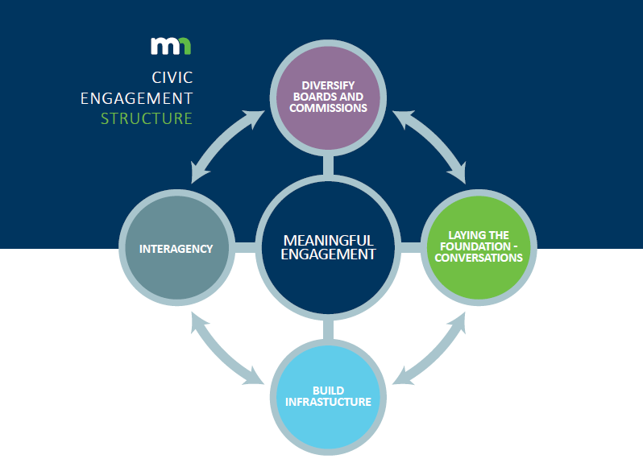
Civic Engagement Plan

Slide 4
Governance Structure
Steering Committee
Vision & Accountability
Practitioners Group
Practice & Network
Implementation Committee
Policy & Culture

Slide 5
The work of our Office
Agency Support
Project Support
Civic Engagement Assessments
Evaluation Metrics and Case Studies
Networking, Coordination, Sharing, Communication
Practitioners Group
Newsletter
Civic Engagement Summit
Training
Civic Engagement Training Series for state employees
Creating Welcoming Board Environments Training
Community Conversations
Meaningful Engagement Conversations
Boards and Commissions Information Sessions

Slide 6
Agency Assessments
A tool developed to assist agencies in assessing their civic engagement efforts, identifying successes and challenges, and ensuring which people within the agency are responsible for completing civic engagement assignments.
Key learnings:
  There are pockets within many agencies that are leading the way in civic engagement.
  More needs to be done to institutionalize civic engagement practice throughout agencies.
  Evaluating and measuring civic engagement continues to be an area of need.
  More needs to be done to share and learn from successes of each other.

Slide 7

Diversifying Boards and Commissions
In November and December, the State contracted with Nexus Community Partners to organize a series of Information Sessions around MN to recruit new and diverse voices onto state boards and commissions.
Provided a training to engage in peer to peer learning on tools related to access, practices and attitudes to create and sustain an inclusive and welcoming board culture. Topics include:
  Recruitment
  Welcoming new board or commission members
  Board governance and cultural practice

Slide 8
Civic Engagement Evaluation Metrics Project
MDHR has contracted with The Improve Group to research civic engagement evaluation metrics, develop a menu of measures and metrics for agencies to use, pilot with three agencies, and develop case write ups of their use.
Pilot Projects:
Environmental Quality Board (EQB) Public Meetings
MnDOT Rethinking I-94 Project
Olmstead Implementation Office (OIO) Community Engagement Outcomes

Slide 9

Practitioners Group
Some past meeting topics:
First Convening and Networking
Training on Foundations of Community Engagement
Development of Civic Engagement Best Practices
Diversity and Inclusion Council Update
State of MN Food Policy Discussion Creating Accessible Documents Training
Digital Engagement Panel

Slide 10
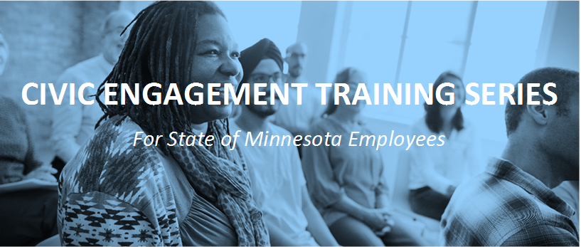
Training Series
Will host 5 training sessions for state employees on civic engagement skills and knowledge:
  Designing Public Events and Meetings
  Stakeholder Analysis
  Conflict Resolution
  Facilitation Skills
  Self-Care
Register now on MDHR website: https://mn.gov/mdhr/news-community/diversity-inclusion/training-series.jsp

Slide 11
Civic Engagement Summit
Working to host a Summit on June 6, 2018 to bring together civic engagement experts from state and local government, community organizations, neighborhood groups, and more, to:
  Build a statewide and cross-sector civic engagement network
  Work together to increase the level of civic participation in government
  Build trust between communities and government
  Strengthen our democracy

Slide 12
Best Practices for Meaningful Engagement

Slide 13
Internal Systems
Value the work of engagement – include in statements to staff, in agency documents, mission, values, etc.
Convene an agency-wide engagement advisory group/committee made up of members of the public.
Include civic engagement in work plans and position descriptions – this is a skill!
Provide/seek out professional development for civic engagement – trainings, workshops, etc.
Measure and evaluate your engagement.
Adopt a public meeting checklist.

Slide 14
Externally
Write public materials in plain language.
Get out of the office and develop relationships with community leaders!
Embrace the conflict and tension
Be creative and engaging with your public meetings
  Incorporate small group conversations
  Use interactive exercises
  Think creatively
  Partner with communities to design your meetings
  Use focused questions to gather the input you need
  Mix up public comment periods with small group conversations and opportunities to build relationships
Articulate how the public input impacted your decision

Slide 15
Let’s continue the conversation
Which of the best practices do you have control over that you can start implementing?
Reach out to our team for help
Participate in the Practitioners Group, Civic Engagement Training Series, and the Summit.

Slide 16
Questions?
Nick Kor | Civic Engagement Director
nicholas.kor@state.mn.us
651-539-1088
Minnesota Department of Human Rights
625 Robert St N
St. Paul, MN 55415
http://mn.gov/mdhr

